Slide 1

BERT Bi-directional Encoder Representations from Transformer
CSE425 Neural Networks
Presented by: Subhi Bhuiyan
ID: 17201116

Slide 2
What is BERT?
BERT is a neural network-based technique for
natural language processing pre-training.

Slide 3
HISTORY
In 2018, Google introduced and open-sourced BERT.
BERT is designed to help computers understand the meaning of ambiguous language in text by using surrounding text to establish context.
BERT is currently being used at Google to optimize the interpretation of user search queries.

Slide 4
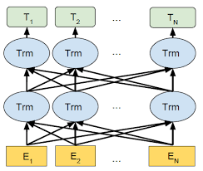
CONCEPT
BERT is based on the transformer
Bi-directional capability
It shows deeper sense of language context
BERT effectively addresses ambiguity

Slide 5
What is BERT used for?
Sequence-to-sequence based language generation tasks
Natural language understanding tasks
Question answering
Abstract summarization
Sentence prediction
Conversational response generation
Polysemy & Coreference resolution
Word sense disambiguation
Natural language inference
Sentiment classification

Slide 6
ADVANTAGES
01
04
02
05
03
06
better model performance over legacy methods
capabilities to fine tune your data to the specific language context
ability to process larger amounts of text and language.
Allows fast fine-tuning
easy route to using pre-trained models (transfer learning)
not limited to Semi-supervised Sequence Learning

Slide 7
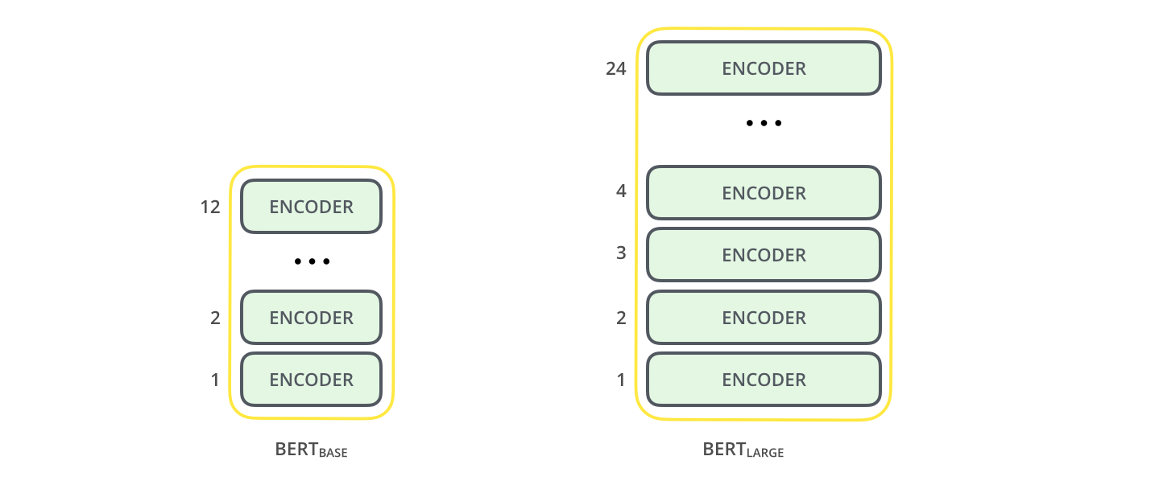
BERT’s Architecture
BERT Base:
12 Encoders with 12 bidirectional self-attention heads
768-hidden-nodes and 110 million parameters
BERT Large:
24 Encoders with 16 bidirectional self-attention heads.
1024-hidden-nodes and 340 million parameters

Slide 8
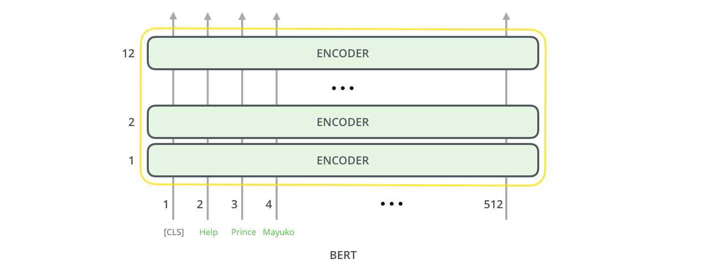
BERT’s Architecture
MODEL INPUT
First input token supplied with special [CLS]
BERT takes a sequence of words as input flowing up the stack
Each layers applies self-attention, result passed through FFNN and hands it off to the next encoder

Slide 9
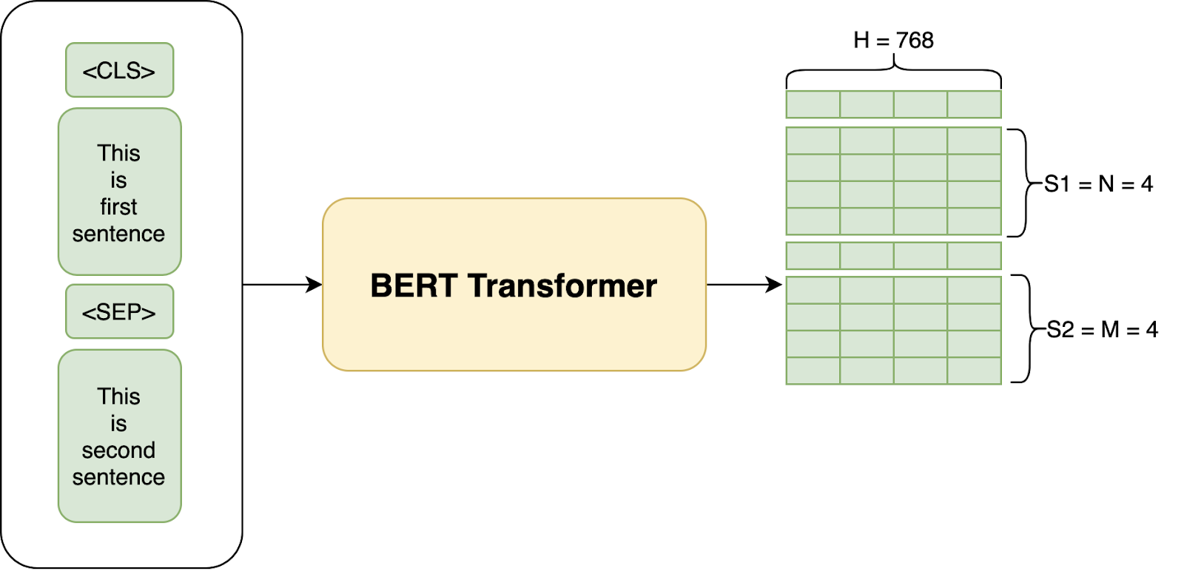
BERT’s Architecture
MODEL OUTPUT
Each position outputs a vector of hidden size (768 in BERT Base)
The vector is then used as the input for a classifier

Slide 10
BERT Pre-Training Phase
MLM
NSP
Masked Language modelling (MLM)
for predicting the original value
of masked words
Next Sentence Prediction (NSP)
for predicting the next sentence in the pair if
is the subsequent sentence in the original document
Both of these are unsupervised tasks
In this pre-training phase BERT focuses on understanding language and context

Slide 11
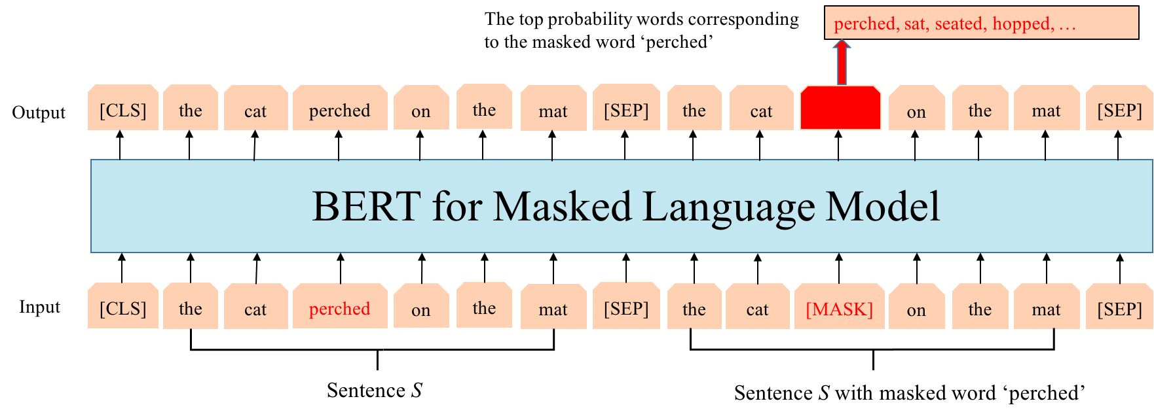
Masked Language Modelling
MLM
Adding a classification layer on top of the encoder output
Multiplying the output vectors by the embedding matrix, transforming them into vocabulary dimension
Calculating the probability of each word in the vocabulary with SoftMax

Slide 12
Next Sentence Prediction
NSP
Pre-processing the Input
Predicting connection of the next sentence
A [CLS] token is inserted at the beginning of the first sentence
A [SEP] token is inserted at the end of each sentence
A sentence embedding indicating Sentence A or B is added to each token.
A positional embedding is added to each token to indicate its position in the sequence
The entire input sequence goes through the Transformer model
The output of the [CLS] token is transformed into a 2x1 shaped vector
Calculating the probability of IsNextSequence with SoftMax

Slide 13
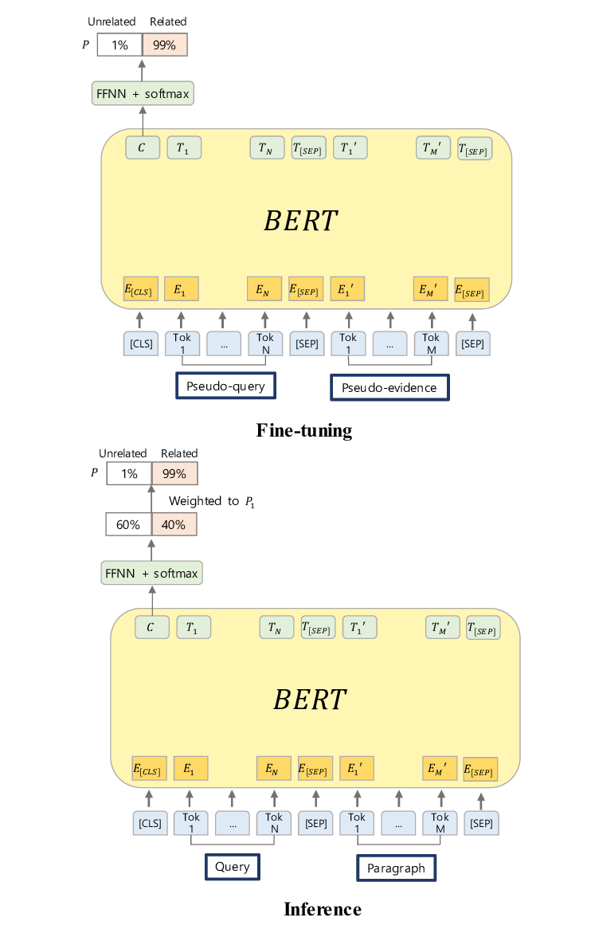
BERT Fine-Tuning Phase
Used for addressing various NLP problems
Used on smaller task-specific datasets
Accomplished by adding a single tuning layer on the top of the core model of BERT

Slide 14
Differences with other Neural Networks
BERT is bi-directional whereas RNN and LSTM are directional.
Does not need decoders like Transformer model.
BERT has no dependency like the others.
BERT classifier is better than the DNN classifier built with universal sentence encoder.

Slide 15
Limitations
01
02
03
04
lack of ability to handle long text sequence.
compute-intensive at inference time.
costly
05
06

Slide 16
References
01
02
https://en.wikipedia.org/wiki/BERT_(language_model)
https://searchenterpriseai.techtarget.com/definition/BERT-language-model
https://www.revuze.it/blog/bert-nlp/
https://huggingface.co/transformers/training.html
03
04
05
06

Slide 17
Thankyou

